Slide 1


AI Application System
(ISE4132)
Week _ Lecture
ISE Department Prof. Mehdi Pirahandeh
School of Global Convergence Studies

Slide 2
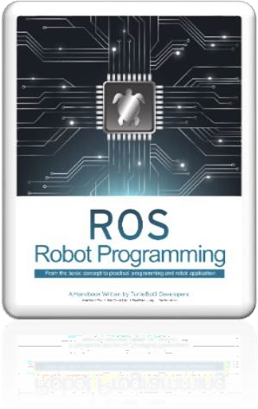
Contents
Actor-Critic Algorithm
Proximal Policy Optimization (PPO) Algorithm
School of Global Convergence Studies

Slide 3
I. Actor-Critic Algorithm

Slide 4


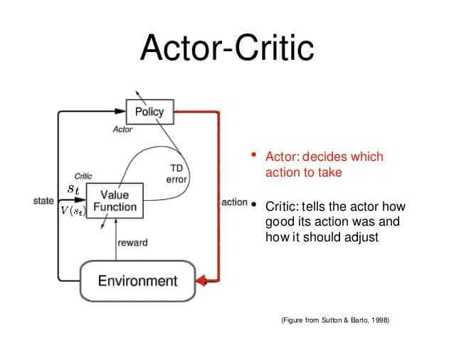


Advantages of Actor Critic Methods
You could do something different
You had better do that movement earlier
You had better play faster
Amateur Player
(Actor)
Pro Player
(Critic)
School of Global Convergence Studies
Notes:
- If you are learning to play some game, one of the best ways to improve is to get a stronger player to review your games. Sometimes the most useful feedback just points out where you won or lost the game. The reviewer might give comments like, ‘You could do something different’, ‘You had better play faster’.
Why is this feedback helpful? You might not have time to fully analyze game environment while playing it, but you can focus your full attention to the most important moments. The reviewer lets you know which part of the game or which actions are important.
Reinforcement-Learning researchers apply this principle in actor-critic learning, which is a combination of policy learning and value learning. The policy function plays the role as the actor: it picks what move to perform. The value function is critic: it tracks whether the agent is ahead or behind in the course of the game. That feedback guides the training process, in the same way that a game review can guide your own learning.
We will learn how to make a self-improving game AI with actor-critic learning

Slide 5
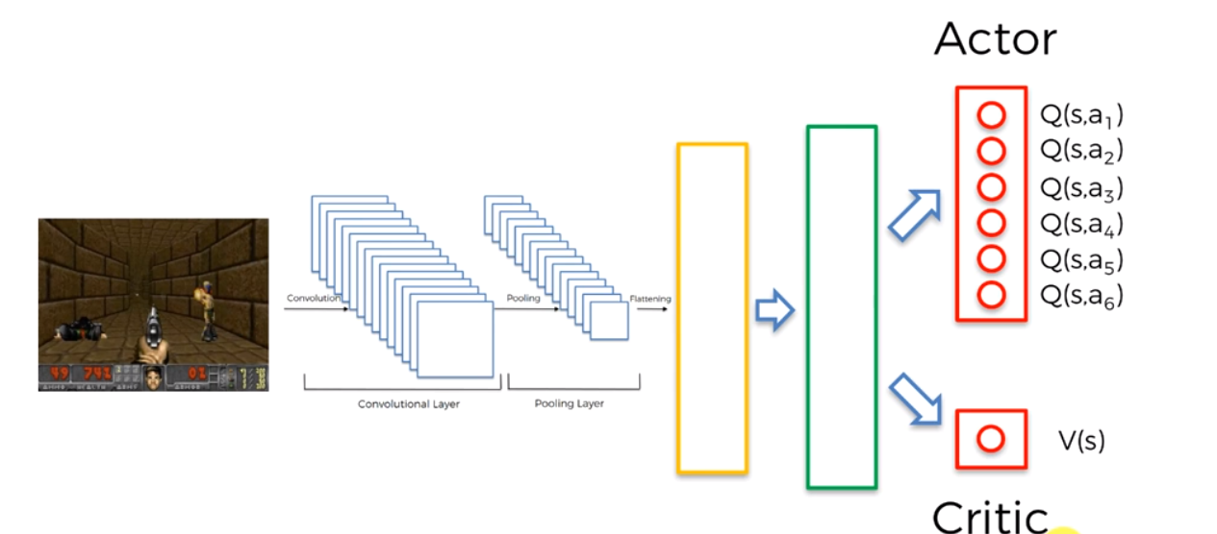
Designing Neural Network
Two networks/models
Policy network (actor)
Value estimation network (critic)
Both can share some initial weights.
School of Global Convergence Studies
Notes:
We need two networks – one for policy network (actor) and another one for value estimation network (critic).
In actual design, the both policy network and value estimation network can share some initial weights.
It is actually a desirable design choice for faster convergence.

Slide 6
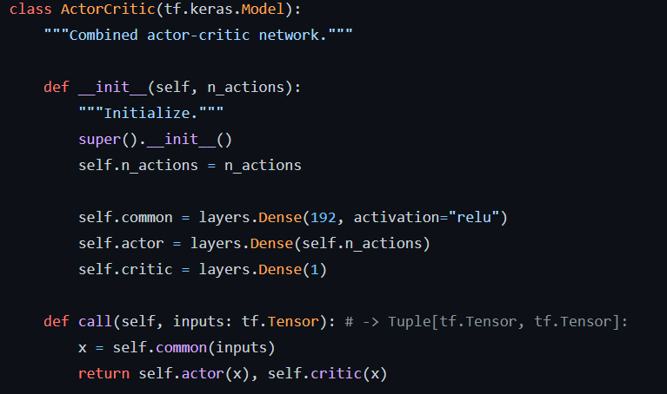
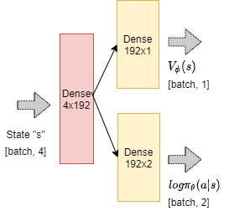
Designing Neural Network
Environment – CartPole
School of Global Convergence Studies
Notes:
Lets first talk about the network. We will have a joint network with shared weights, one producing the policy action probabilities and another the value of state.
For the environment ‘CartPole’, it is a fairly simple network and is given in the figure.
You can see the implementation of that network in Tensorflow as shown.

Slide 7
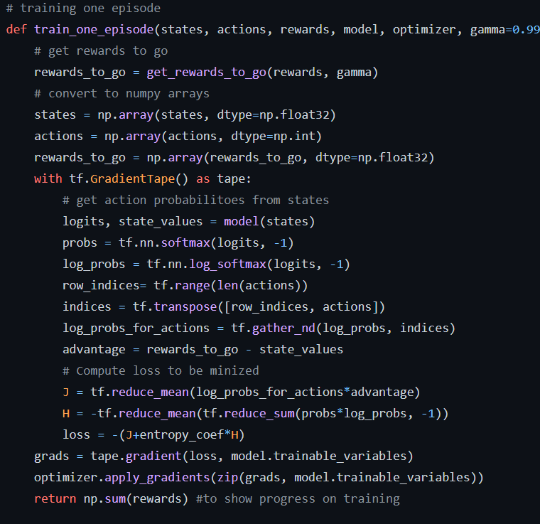
Training an Actor-Critic Agent
train_one_episode
for Actor-Critic using MC Rewards
School of Global Convergence Studies
Notes:
MC Learning – Monte Carlo Learning (https://towardsdatascience.com/monte-carlo-learning-b83f75233f92)

Slide 8

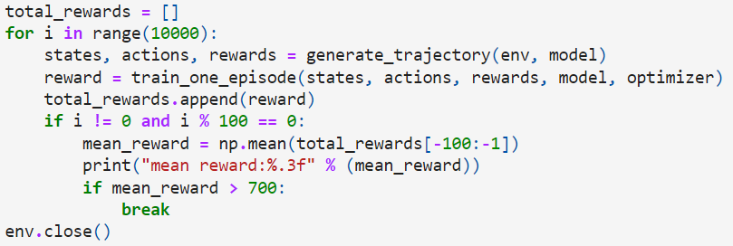
Training an Actor-Critic Agent
optimizer – Adam
School of Global Convergence Studies
Notes:
As an exercise you can take different neural networks and try to increase the performance

Slide 9
II. Proximal Policy Optimization (PPO) Algorithm

Slide 10
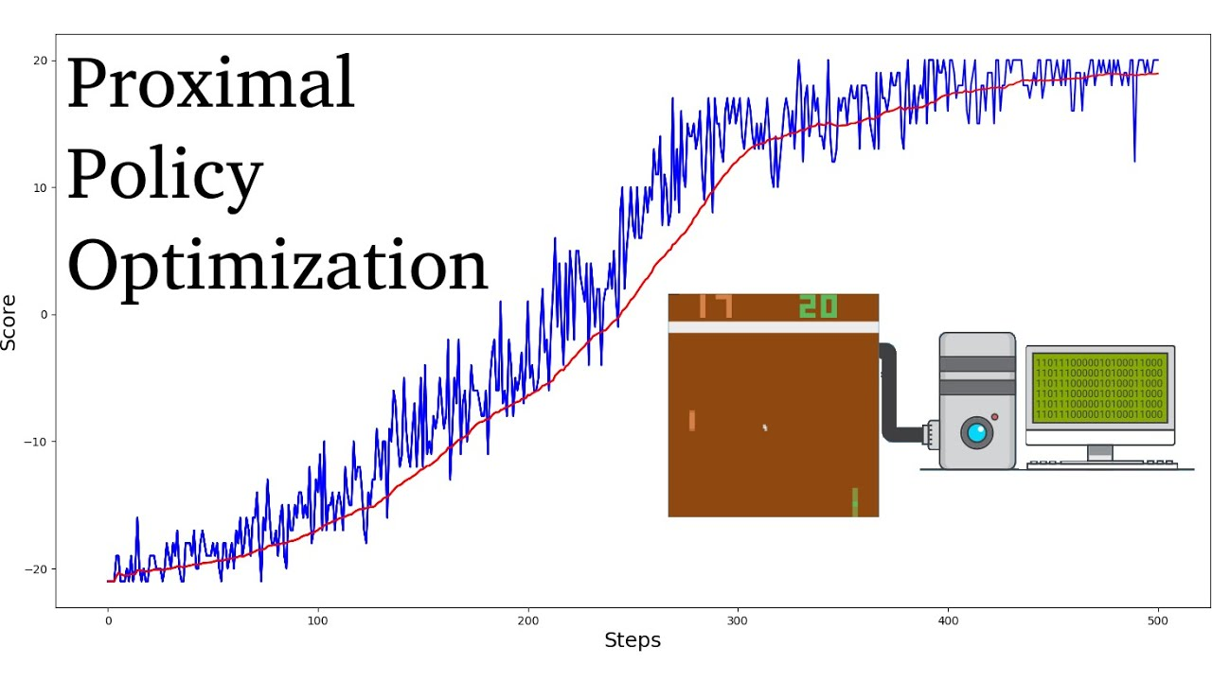
PPO Algorithm
“How can we take the maximum possible step size in policy parameters without going too far and getting to a worse policy that the original one before update?”
The PPO simpler to
implement and has
empirically been shows
to perform well
School of Global Convergence Studies
Notes:
Proximal Policy Optimization (PPO) is also motivated by the question
“How can we take the maximum possible stem size in policy parameters without going too far and getting to a worse policy that the original one before update?”
The PPO-clip variant depends on clipping the gradients in the objective function such that the update has no incentive to move the policy too far from the original step.
PPO is simpler to implement and has empirically been show to perform well.

Slide 11
PPO Algorithm
We will use OpenAI’s library called Baselines (https://github.com/openai/baselines)
Implementations for the popular and newest algorithms.
Another library: Stable Baselines3 (based on Baselines)
(https://stable-baselines.readthedocs.io/en/master/)
School of Global Convergence Studies
Notes:
This time, instead of coding it ourselves, we will use a library. OpenAI has a library called Baselines. It has implementations for many of the popular and newest algorithms.
There is another library that is based on Baselines called Stable Baselines 3.

Slide 12
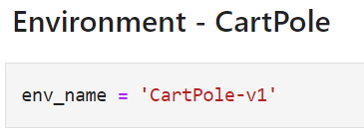
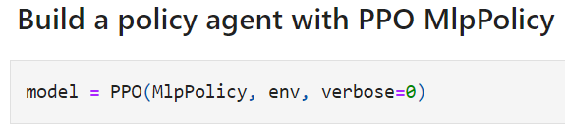
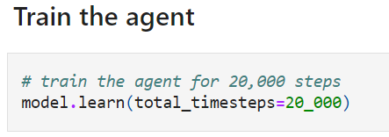
PPO Algorithm
School of Global Convergence Studies
Notes:
Our code will follow as:
We will not be explicitly defining the policy network
We will not write the training step of calculating loss and stepping through the gradient ourselves
We will walk through the code snippet of creating an agent, training it on ‘CartPole’ environment, and evaluating the performance

Slide 13
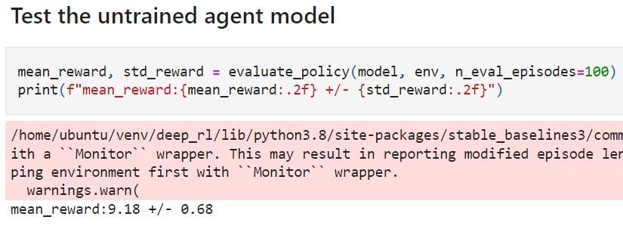
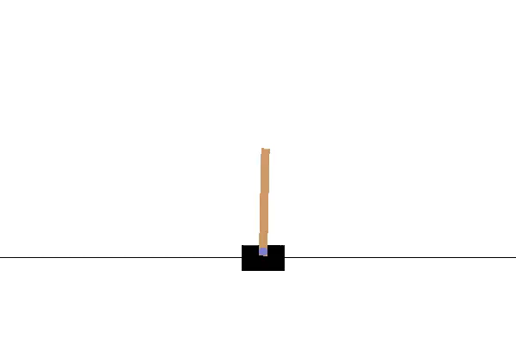
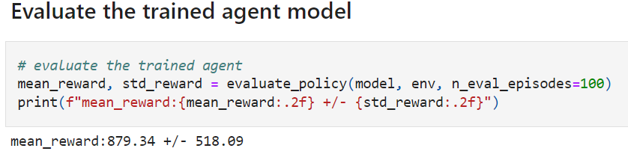
PPO Algorithm
School of Global Convergence Studies
Notes:
You can see the difference between the untrained and trained agent models.
Try to improve the performance of the agent model

